Slide 1


ANALYSIS OF DIABETES DATASET
ANKIT CHACHADA
TILAK SHENOY
KARTHIK KARUNANITHI

Slide 2

Introduction
Reason to choose Diabetes dataset
Algorithms
Execution
Results
Final statistics and comparison

Slide 3




Why data mining?
Small amount of data
Increase in size
Increase with size, complexity and unproven technology
A computational process of discovering patterns in large data sets ("big data") involving methods at the intersection of artificial intelligence, machine learning, statistics, and database systems.

Slide 4
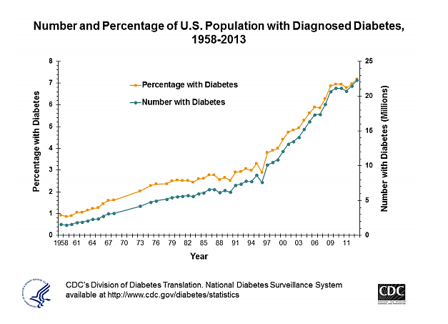
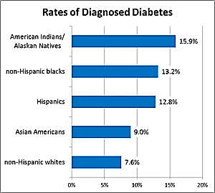
Why Diabetes Dataset ?

Slide 5

Goal
Our Analysis can be useful in the field of Medical Science
Data mining can unearth hidden knowledge from a huge amount of diabetes-related data.
Help diabetes research and ultimately improve the quality of health care for patients.

Slide 6


Tool & Language
R - studio
R – Programming
Open Source IDE for R Programming
Language for statistical computing and graphics

Slide 7
Source of the dataset
https://archive.ics.uci.edu/ml/datasets/Diabetes+130-US+hospitals+for+years+1999-2008
Represents 10 years (1999-2008) of clinical care at 130 US hospitals
100,000 records over 50 attributes
Attributes
Patient Number, Race, Gender and Age
Number of Tests Performed
A1c test Result and Glucose Serum Test
Number of Medication and Diabetic Medications

Slide 8
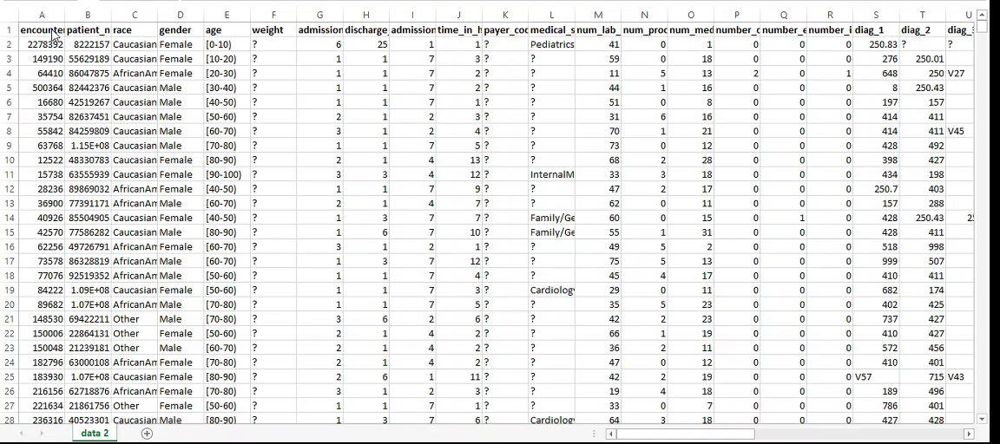
Actual Dataset

Slide 9
Normalization ,Classification, New Dataset Creation
norm <-function(x,minx,maxx)
{
z<-((x-minx)/(maxx-minx))
return(z)
}
Race_num <- ifelse(Dataset$race=='Caucasian',1,
ifelse(Dataset$race=='Asian',2,
ifelse(Dataset$race=='AfricanAmerican',3,
ifelse(Dataset$race=='Hispanic',4,0))))
New_Dataset <- cbind(Race=race_num
,num_lab_procedures=norm(Dataset[,13],min(Dataset[,13]),max(Dataset[,13]))
,num_procedures=norm(Dataset[,14],min(Dataset[,14]),max(Dataset[,14]))
,metformin=Metformin_Info
,insulin=Insulin_Info)
View(New_Dataset)

Slide 10
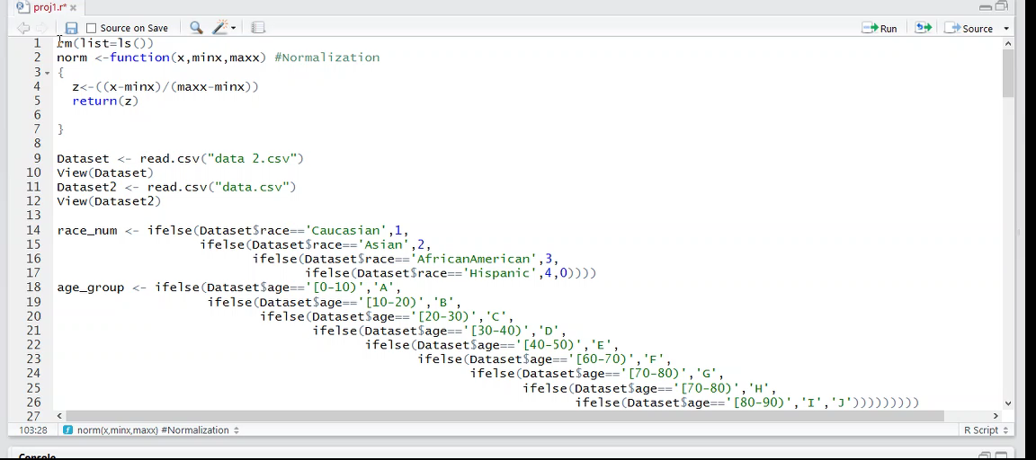

Slide 11
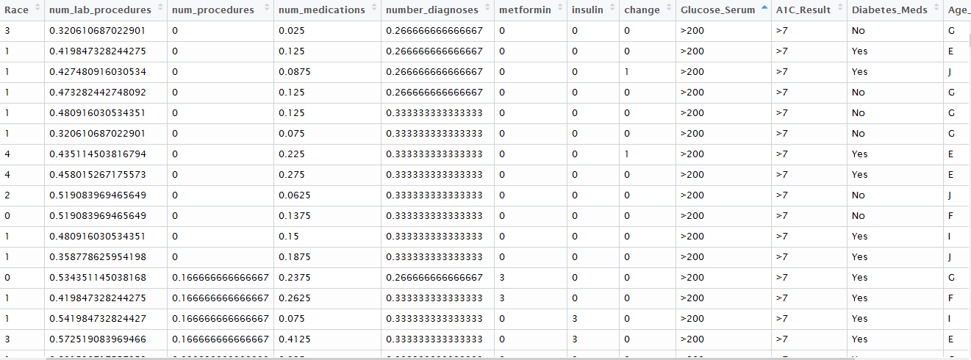
Transformed Dataset

Slide 12
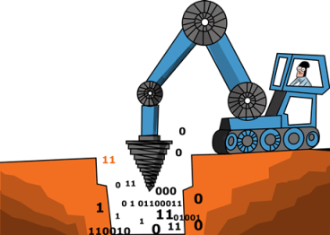
Algorithms used
Classification
Naïve Bayes
K-nearest neighbor (KNN)
Clustering
K means clustering

Slide 13
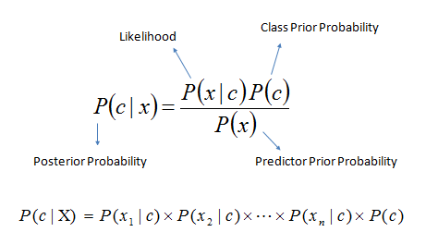
Naïve Bayes algorithm
Based on Bayes’ theorem with independence assumptions between predictors
A1C result
Information about a person’s average levels of blood glucose, also called blood sugar
Naive_Bayes <- naiveBayes(A1Cresult~gender+race+age+metformin+insulin +change+diabetesMed, data)

Slide 14
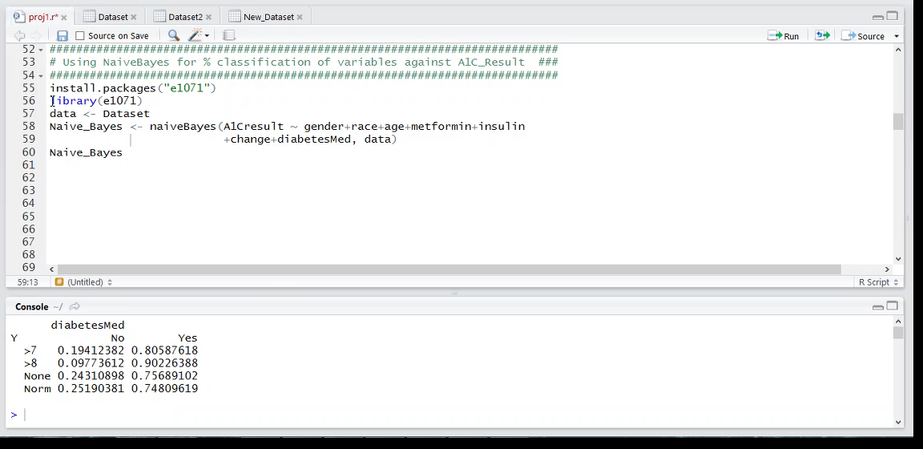
Execution

Slide 15
Results
A1C Result vs Gender
A1c Result | Female | Male
>7 | 51.31% | 48.68%
>8 | 50.10% | 49.89%
Pre-diabetes | 54.19% | 45.79%
Normal | 54.18% | 45.81%
A1C Result vs Race
A1c Result | African American | Asian | Caucasian | Hispanic | Others
>7 | 14.66% | 0.94% | 77.83% | 2.57% | 3.98%
>8 | 22.45% | 0.754% | 68.63% | 3.22% | 4.92%
Pre-diabetes | 18.52% | 0.597% | 75.45% | 1.82% | 3.60%
Normal | 22.16% | 0.741% | 71.12% | 2.56% | 3.40%

Slide 16
Results cont….
A1C Result vs Age Group
A1c Result | [0-10) | [10-20) | [20-30) | [30-40) | [40-50) | [50-60) | [60-70) | [70-80) | [80-90) | [90-100)
>7 | 0.05% | 0.36% | 0.78% | 2.41% | 8.68% | 16.34% | 22.71% | 27.33% | 18.52% | 2.78%
>8 | 0.99% | 3.40% | 4.06% | 7.30% | 15.68% | 22.32% | 20.49% | 16.18% | 8.43% | 1.09%
Pre-diabetes | 0.08% | 0.40% | 1.42% | 3.39% | 8.83% | 16.36% | 22.34% | 26.57% | 17.64% | 2.91%
Normal | 0.18% | 1.12% | 1.68% | 4.04% | 11.54% | 18.59% | 19.19% | 23.52% | 16.89% | 2.48%
TYPE 1 DIABETES
TYPE 2 DIABETES

Slide 17
Results cont….
A1C Result vs Metformin
A1C Result | Down | No | Steady | Up
>7 | 0.73% | 76.52% | 21.14% | 1.60%
>8 | 0.88% | 74.62% | 21.36% | 3.12%
Pre-diabetes | 0.52% | 81.09% | 17.56% | 0.82%
Normal | 0.64% | 80.26% | 18.07% | 1.02%
A1C Result vs Insulin
A1C Result | Down | No | Steady | Up
>7 | 11.62% | 44.07% | 31.74% | 12.56%
>8 | 19.44% | 26.74% | 33.31% | 20.49%
Pre-diabetes | 11.29% | 48.61% | 29.90% | 10.18%
Normal | 12.08% | 46.27% | 31.22% | 10.42%

Slide 18
Results cont….
A1C Result vs Change of Medications
A1c Result | Change | No Change
>7 | 50.76% | 49.23%
>8 | 65.10% | 34.89%
Pre-diabetes | 44.27% | 55.72%
Normal | 44.20% | 55.79%
A1C Result vs Diabetes Medications
A1c Result | No | Yes
>7 | 19.41% | 80.58%
>8 | 9.77% | 90.22%
Pre-diabetes | 24.31% | 75.68%
Normal | 25.19% | 74.80%

Slide 19
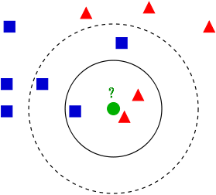
K-Nearest Neighbor algorithm
K-NN uses distance function to calculate the distance between points from the center

Slide 20
Execution Sequence
Step1: Storing 70% of the Transformed dataset as TRAINING DATA and the rest as TEST DATA
temp <- sample(nrow(New_Dataset),as.integer(0.70 * nrow(New_Dataset)))
Training <- New_Dataset[temp,]
Test <- New_Dataset[-temp,]
Step2: A1c results are compared with Race, Diabetes Meds, Age, Glucose Serum Test, Gender, Metformin, Insulin, change of medicines ( Plots and tables )
Predict_a1c <- knn(Training[,1:8], Test[,1:8], Training[,10], k=23)
Step3: Error value for kNN when comparing with A1C result
e_result <- cbind(Test, as.character(Predict_a1c))
false <- e_result[,10]!=e_result[,14]
err_rate <- sum(false)/length(false)

Slide 21
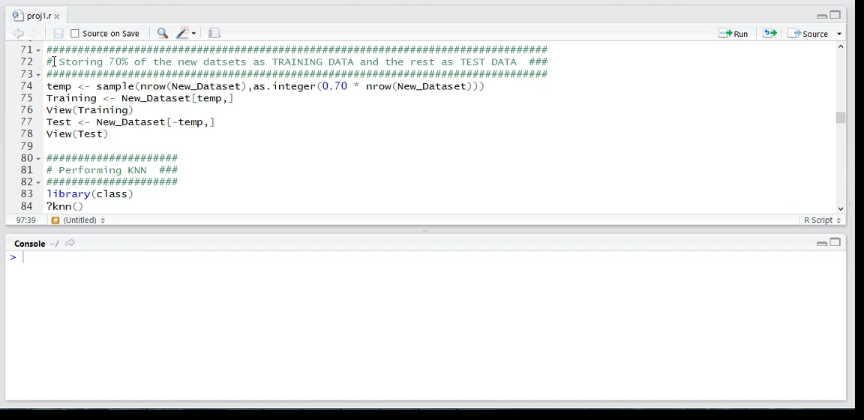

Slide 22
Results
A1C | Female | Male
>7 | 1 | 0
>8 | 64 | 54
Pre-diabetes | 16274 | 14134
Normal | 2 | 0
A1CResult Vs Gender
A1C Result | Down | No | Steady | Up
>7 | 0 | 0 | 0 | 0
>8 | 0 | 97 | 3 | 0
Pre-diabetes | 169 | 24771 | 5490 | 0
Normal | 0 | 0 | 0 | 0
A1CResult Vs. Metformin

Slide 23
Results cont..
A1C | Other | Caucasian | Asian | African American | Hispanic
>7 | 0 | 1 | 0 | 0 | 0
>8 | 2 | 75 | 0 | 41 | 0
Pre-diabetes | 1157 | 22686 | 199 | 5750 | 617
Normal | 0 | 0 | 0 | 2 | 0
A1CResult VS Race
A1C Result | No | Yes
>7 | 0 | 1
>8 | 0 | 118
Pre-diabetes | 6998 | 23411
Normal | 0 | 2
A1CResult VS Diabetic Meds

Slide 24
Results cont..
A1cResult Vs Insulin
A1C Result | Down | No | Steady | Up
>7 | 0 | 0 | 0 | 0
>8 | 27 | 23 | 66 | 0
Pre-diabetes | 3608 | 17620 | 9186 | 0
Normal | 0 | 0 | 0 | 0
A1c | No Change | Change
>7 | 0 | 0
>8 | 56 | 69
Pre-diabetes | 16397 | 14007
Normal | 0 | 1
A1cResult Vs Change of medicines

Slide 25
Results cont..
A1c | >200 | >300 | None | Normal
>7 | 0 | 0 | 1 | 0
>8 | 1 | 1 | 116 | 0
Pre-diabetes | 468 | 393 | 28806 | 742
Norm | 0 | 0 | 2 | 0
A1CResult VS Glucose Serum Test
A1c | A 0-10 | B 10-20 | C 20-30 | D 30-40 | E 40-50 | F 50-60 | G 60-70 | H 70-80 | I 80-90
>7 | 0 | 0 | 0 | 0 | 0 | 1 | 0 | 0 | 0
>8 | 11 | 16 | 7 | 7 | 19 | 14 | 19 | 6 | 19
Pre-diabetes | 40 | 200 | 487 | 1102 | 2869 | 6749 | 7805 | 5152 | 6008
Normal | 0 | 0 | 0 | 0 | 0 | 0 | 0 | 0 | 2
A1CResult VS Age

Slide 26
Comparing the accuracy of K-NN with different values of k

Slide 27
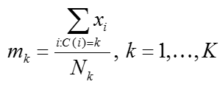
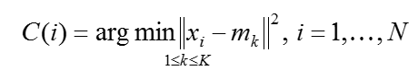
Kmeans clustering
Partition n observations into k clusters in which each observation belongs to the cluster with the nearest mean, serving as a prototype of the cluster.
For a given cluster assignment C of the data points, the cluster means m_{k} is computed by
For a current set of cluster means, each observation are assigned as
The above two steps are iterated until convergence

Slide 28
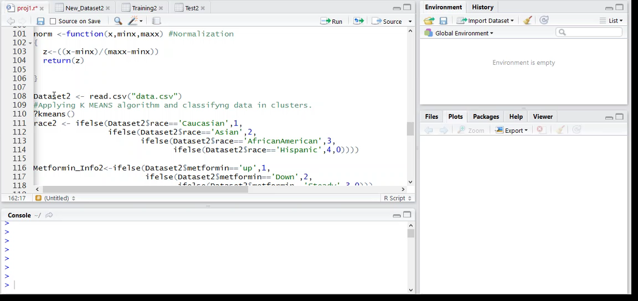
Execution

Slide 29
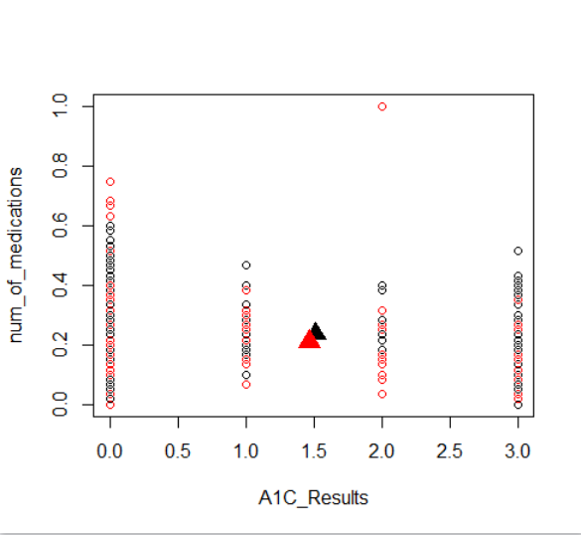
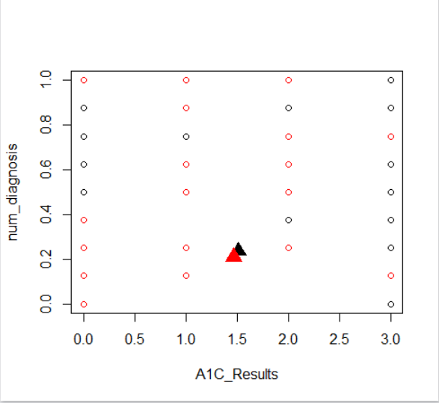
Results

Slide 30
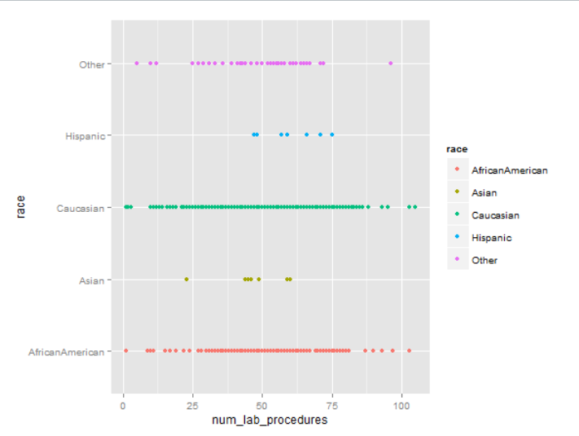
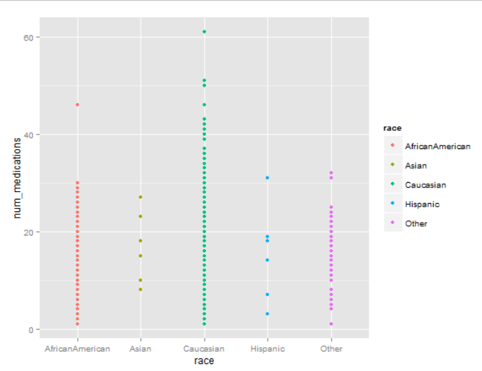
Q-plots

Slide 31

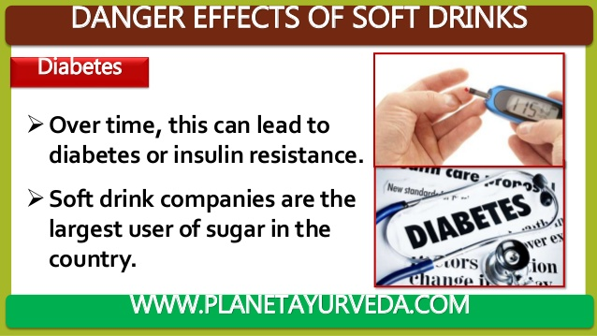
Thank you

